Slide 1
Working with APIs using Postman
By
Utkarsh Dhiman
Full stack web developer & postman student expert
@utkarshdhiman48

Slide 2
Introduction
APIs
Restful APIs
HTTP methods
Postman
Practical
Notes:
I’ll walk you through what are -

Slide 3
API
Application Programming Interface
Notes:
Starting with APIs
Definition -Application Programming Interface
says that it’s something using which you can connect 2 different programs.
full form of API contains a word ‘Interface’.
.
I will explain why I emphasised Interface in a sec.

Slide 4
API
multiply
Math
subtract
add
# My Code
.
.
.
result = add (2, 1)
.
.
.
Notes:
As an example, i have
Math program - exporting some functions
Use Math prog in my own code
.
I’m using this math prog through APIs.
Eg, To interact with TV we use TV remote.
Remote is interface
To interact with Math program I’m using these functions.
Functions are interface
Point - APIs are an intermediate and not the code itself,
use APIs to interact with OS, devices, sensors,

Slide 5
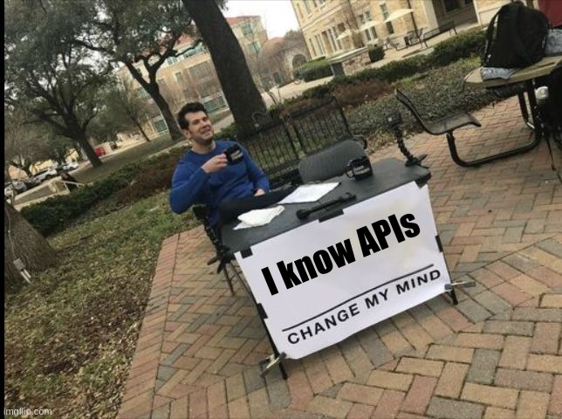
Notes:
You have some familiarity.

Slide 6
RESTful API
Representational State Transfer
Notes:
different kind of APIs, we call them RESTful APIs.
‘RESTful’ because they follow constraints defined by REST.
In easy words.

Slide 7
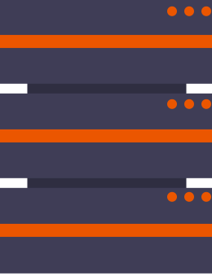
Server
HTTP Request
HTTP Response
URI/
Api endpoint
Notes:
need to interact with some remote server and we do that through HTTP requests.
Dher sara data
Endpoints users, activity etc
.
We send a request to one of the endpoints of server, and the server responds back.
RESTful -Endless use cases. Social media, videos, auth, NASA gallery.

Slide 8
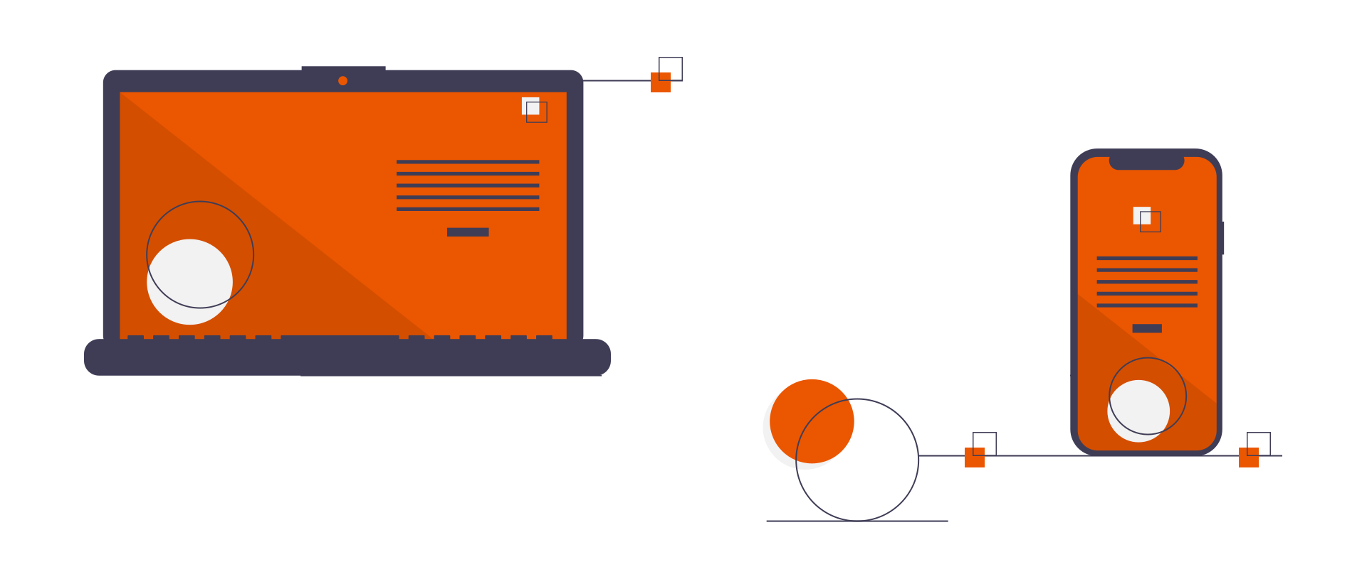
RESTful API
Notes:
RESTful APIs implemented in backend.
responsible only for transferring raw data.
In JSON, XML etc
Companies - Separate backend and frontend
With this we can use a single backend to power web apps, mobile apps and desktop apps.
Ok, For the rest of the session I’ll refer to RESTful APIs as just APIs.

Slide 9
HTTP request methods
GET
To get an existing resource
POST
To create a new resource
PUT
To update an existing resource
DELETE
To delete an existing resource
Notes:
Don’t always get data, Sometimes send data.
Just a request
That’s where HTTP methods are used to differentiate requests.
Easy And they are quite self explanatory.
.(explain)
As a result to these requests APIs respond with data or simply acknowledgement.

Slide 10

Postman
API Client
Automated Testing
Stimulate APIs
Collaboration
Workspaces
Documentation
Notes:
Say Hi to the postman.
Wonder what, why postman?
Browser with more control
Now both frontend and backend developers use postman.
As a backend developer I need to check what am I sending as a response to a call for my API.
Also I need to make sure no unauthorized person can access my API, etc.
The frontend is yet to be implemented so how will i check, i check through POSTMAN.
As a frontend developer I need to check what an API is sending as a response.
Of Course it can be printed in console, but it involves time and writing code to make the response printable. Some platforms or languages do directly support server responses like JSON/XML.
Its much better to use POSTMAN.

Slide 11
Practical
Notes:
Time for practical
I’ve made an API.
Besides that every API has a documentation,
No need to remember anything about how to use APIs
always refer to documentation.

